Slide 1


Project Presentation on
R.K Jewellery Shop
GROUP NO-3(MCA SEM-IV)
Developed By:
Name:Barot Jayrajkumar Rakeshkumar Internal Guided By:
PRN:24032010100004 Ms. Vandana G Patel(ASST . Prof)
2.Name: Prajapati Ketulkumar Sureshbhai External Guided By:
PRN :24032010100036 Mr.Dhruv Makwana
Submit to :
Department of Computer Application (MCA)
Sankalchand Patel College of Engineering
Sankalchand Patel University, Visnagar

Slide 2

Project Details:-
Title | Description
Project Title | R.K jewellery Shop
Objective | To develop a secure, user-friendly, and efficient online jewellery shopping system that allows customers to browse, select, and purchase jewellery products digitally while enabling administrators to manage products, orders, and inventory effectively..
Project Internal Guide | Ms. Vandana G Patel
Project External Guide | Mr. Dhruv Makwana
Team Size | 2
Team Member | Barot Jayrajkumar Rakeshkumar Prajapati Ketulkumar Sureshbhai
Front End Tool | HTML , CSS , JAVASCRIPT , BOOTSTRAP
Back End Tool & Database | PYTHON , DJANGO , SQL LITE DATABASE
Operating System | Windows 10/11

Slide 3
Organization Details:-
Name | Tech Innovation Pvt ltd
Address | Iconic Shyamal, Near Satellite Road, Ahmedabad, Gujarat, India
Website | www.techinnovationit.in
E-Mail | techinnovationpvtltd@gmail.com
Contact | +91 9512639191
Owner | Vivek Thakkar
About Company | Passionate tech professional skilled in [software development, project management], focused on innovation, problem-solving, and delivering impactful solutions.

Slide 4
Existing System :-
1.The E-Commerce Jewellery Shop is developed using Python Django to provide an easy online jewellery shopping experience.
2.Online Jewellery Shopping: Customers can browse and purchase jewellery items such as rings, necklaces, earrings, and bracelets easily.
3.User Authentication System: The platform allows users to register, log in, and manage their personal accounts securely.
4.Shopping Cart and Payment: Users can add products to a cart, proceed to checkout, and make secure online payments.
5.Admin Management System: The administrator can manage products, categories, orders, and stock using Django’s admin panel. 💎

Slide 5
Problems in Existing System :-
1.Manual Record Keeping: Product details, billing, and invoices are maintained manually in registers, which increases paperwork and effort.
2.Data Redundancy & Errors: The same information is written multiple times, leading to duplication and a higher chance of mistakes.
3.Limited Customer Access: Customers must visit the shop physically since there is no online shopping facility, limiting business reach.
4.Inventory and Security Issues: Stock is updated manually with no real-time tracking, and records can be lost due to lack of proper security and backup.

Slide 6
E-Commerce Jewellery Market Trends:-
1. Fast Online Market Growth
The online jewelry market is expanding rapidly with strong annual increases in global sales. Online jewelry sales are projected to reach around $166 billion by 2029, growing steadily year after year. Oberlo
Another forecast shows the market may grow by about USD 78 billion between 2024 and 2029, indicating high demand for internet shopping. giiresearch.com
2. Increasing Consumer Confidence & Adoption
More shoppers are comfortable buying jewelry online due to convenience, better product variety, and competitive pricing compared to physical stores. jewel360.com
Younger consumers (especially under age 35) make up a large share of online jewelry buyers, showing digital channels dominate among this demographic. Digital Commerce 360
3. Smartphone & Social Commerce Influence
Social media and platform shopping (like social selling and influencer promotions) are driving jewelry visibility and online sales, expanding the reach of e-commerce jewelry stores. consegicbusinessintelligence.com
4. Technological Enhancements
Tools like Augmented Reality (AR) virtual try-ons and AI-based recommendations are becoming popular to help customers explore products before buying. jewel360.com
Enhanced website features, interactive catalogs, and high-quality visuals help build user trust and reduce returns. consegicbusinessintelligence.com
5. Growth in Specific Regions
In countries like India, the jewelry market is expanding fast, driven by e-commerce adoption, with projections for continued high growth over coming years. IMARC Group
Middle-East and Asia Pacific regions also show strong online jewelry demand due to rising internet use and consumer disposable income. reportsanddata.com
6. Personalized & Direct-to-Consumer Trends
Personalized jewelry options and direct-to-consumer business models are gaining traction, helping brands strengthen customer engagement online

Slide 7
Admin Module
Category Management
  • Add Category
  • Update Category
  • Filter Category
  • Delete Category
Product Management
  • Add Products
  • Update Products
  • Filter Products
  • Delete Products
User Management
  • Update Users
  • Filter Users
  • Delete Users
Order Management
• View Orders
• Process Orders

Slide 8
Customer Module
  Home
    View homepage
    Browse featured products
  Category Browsing
    View / Select Category
  Brand Viewing
    View / Select Brand
  Subcategory Selection
    View / Select Sub Category
  Product Viewing
    View / Select Product Details
  Cart Management
    Add to Cart
  Checkout
    Confirm Order
    Enter Shipping Details
  Payment
    Online Payment
    Cash on Delivery
  Rating & Review
    Give Rating
  Profile Management
    Manage Profile
  Logout
    Secure Logout

Slide 9
Time Line Chart:-

Slide 10
Months | December |  | January |  |  |  | February |  |  |  | March |  |  |  | April
Week | 3 | 4 | 1 | 2 | 3 | 4 | 1 | 2 | 3 | 4 | 1 | 2 | 3 | 4 | 1 | 2
Definition
System Analysis
Database design
Diagram Design
Documentation

Slide 11
Hardware Specifications:-
Component | Developer Side | Admin Side | Client Side
Processor | AMD Ryzen 5 5600H | Intel i5 (10th Gen) | Intel i5 (3rd Gen)
RAM | 8 GB | 4 GB or Above | 2 GB or Above
HDD / SSD | 512 GB | 256 GB | 128 GB

Slide 12
Software Specifications:-
Developer Side | Admin Side | Client Side
Front-end: HTML, CSS, JavaScript, Bootstrap | Operating System: Almost all operating systems supported (Windows, Linux, macOS) | Operating System: Almost all operating systems supported (Windows, Linux, macOS)
Back-end: Python, Django | Browser: Google Chrome, Mozilla Firefox, Microsoft Edge, etc. | Browser: Google Chrome, Mozilla Firefox, Microsoft Edge, etc.
Database: SQLite | Access Type: Admin login with full control | Access Type: Client/User login
Application Server: Django Development Server | Internet Requirement: Required | Internet Requirement: Required
Code Editor: Visual Studio Code | — | —

Slide 13
System Design Diagram

Slide 14
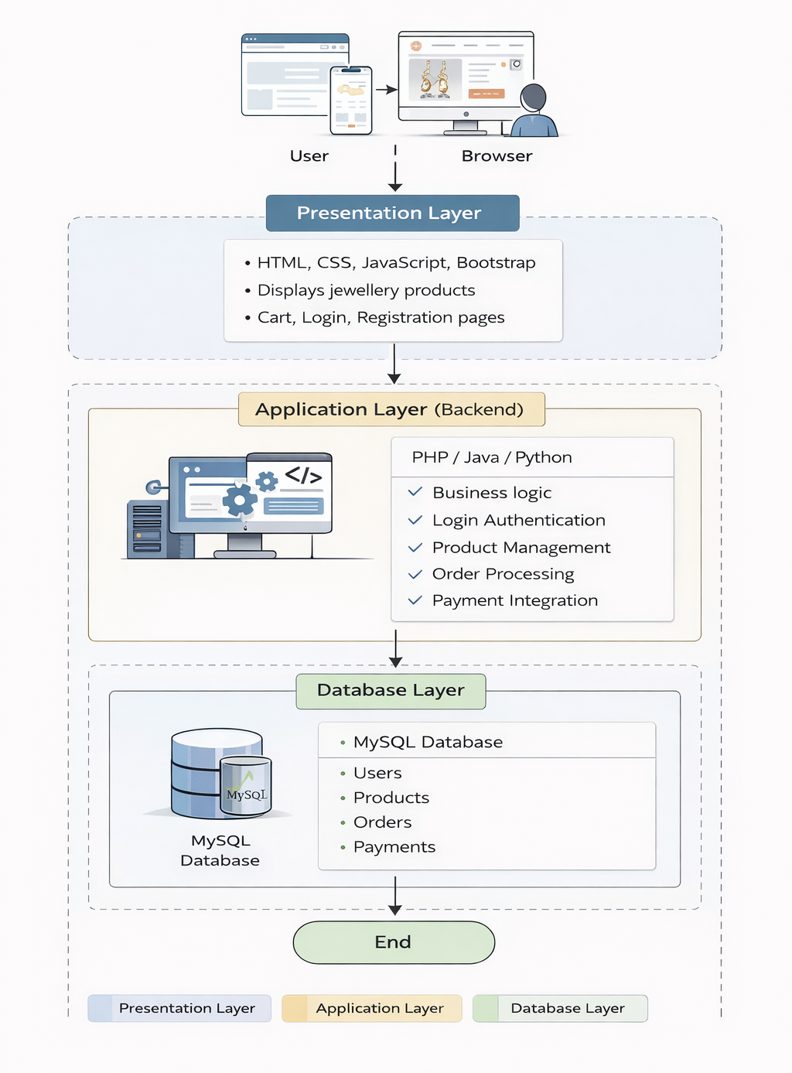

Slide 15
Flow Chart

Slide 16
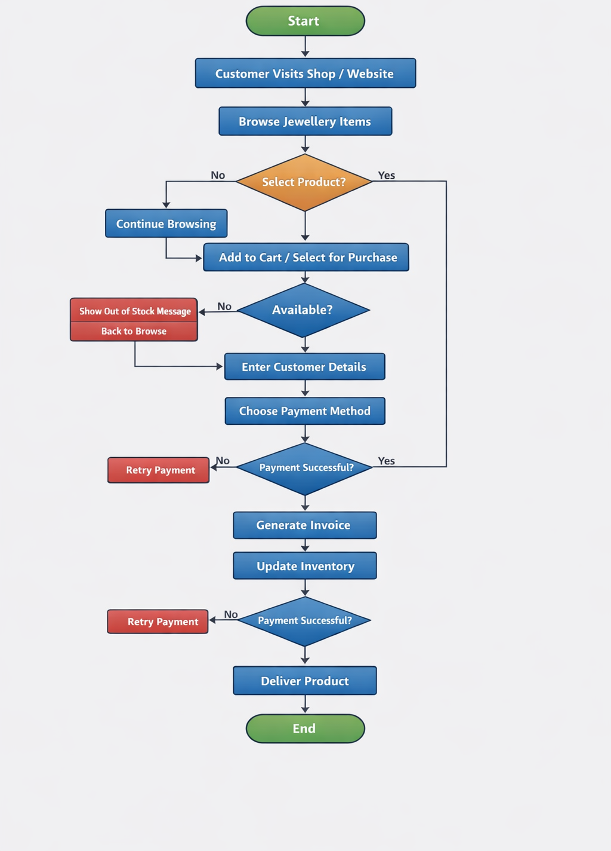

Slide 17
ER-Diagram:-

Slide 18
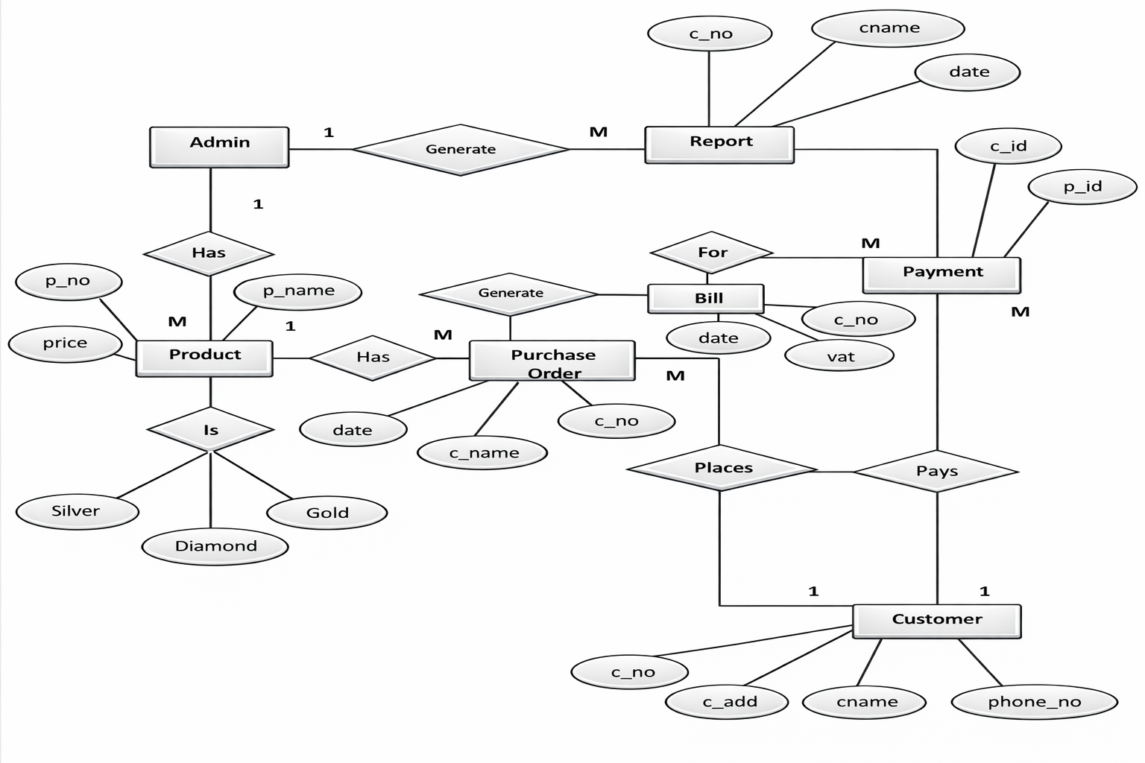

Slide 19
UML Diagram
Use Case Diagram
Class Diagram
Admin Activity Diagram
User Activity Diagram
Sequence Diagram
State Diagram
Deployment Diagram

Slide 20
Use Case Diagram:-

Slide 21
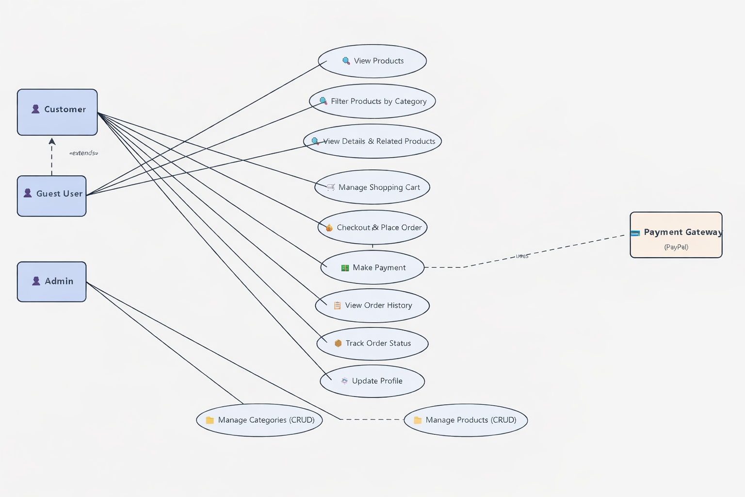

Slide 22
Class Diagram:-

Slide 23
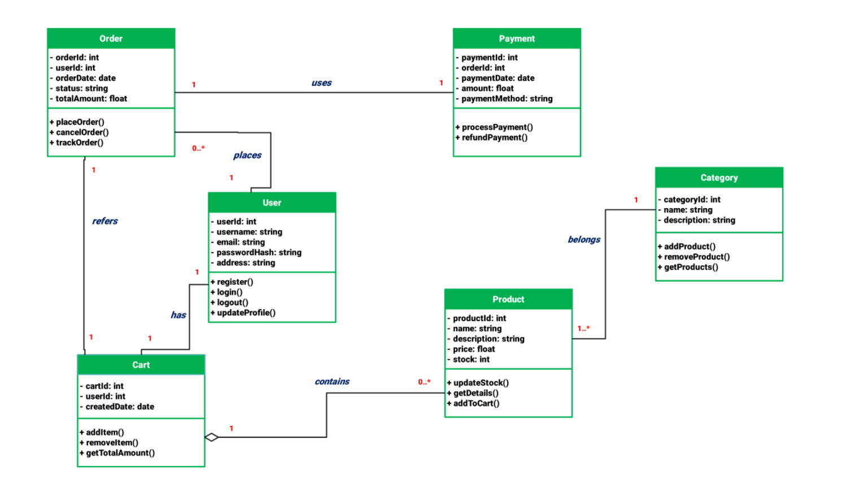

Slide 24
Activity Diagram:-

Slide 25
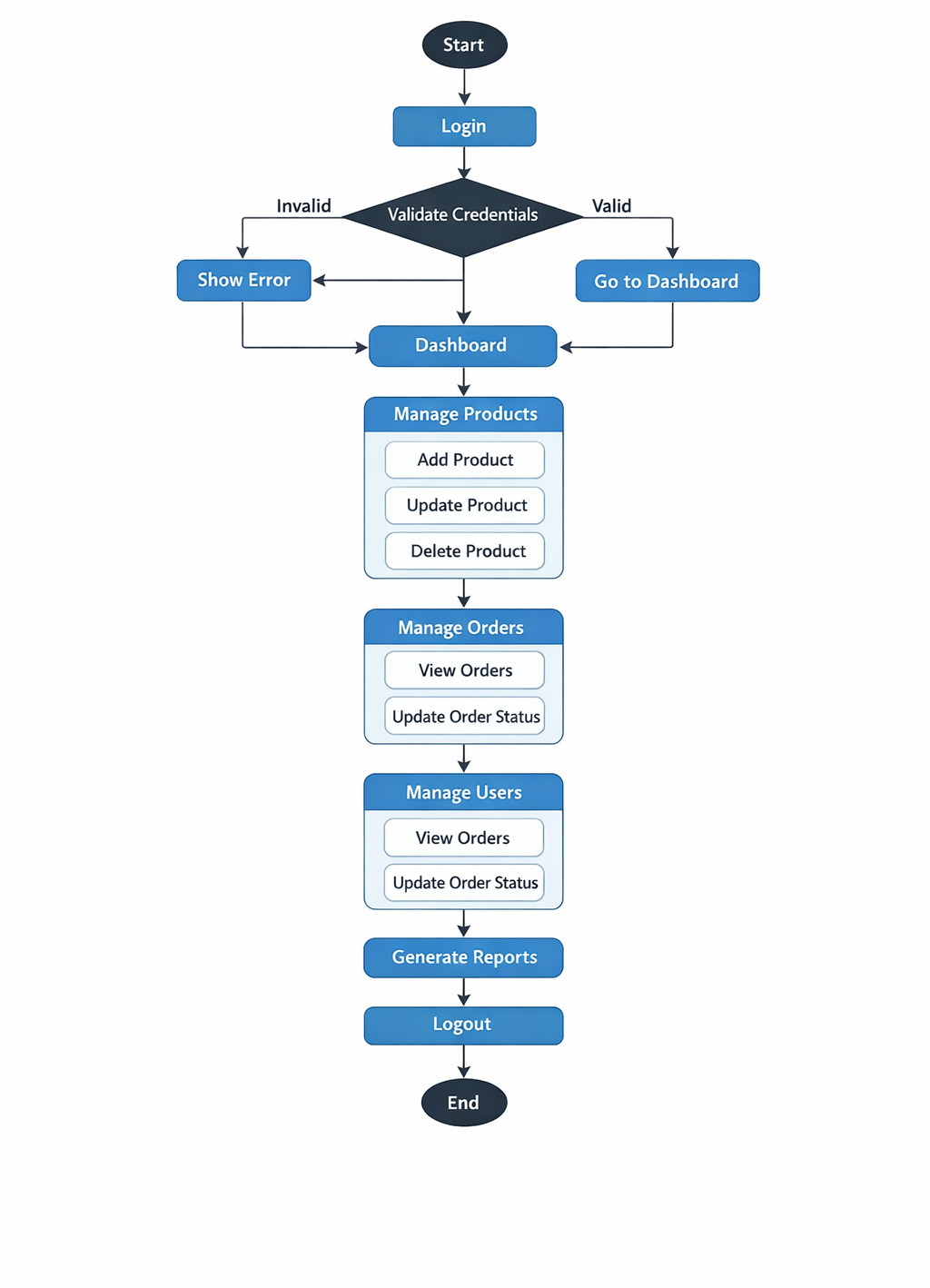

Slide 26
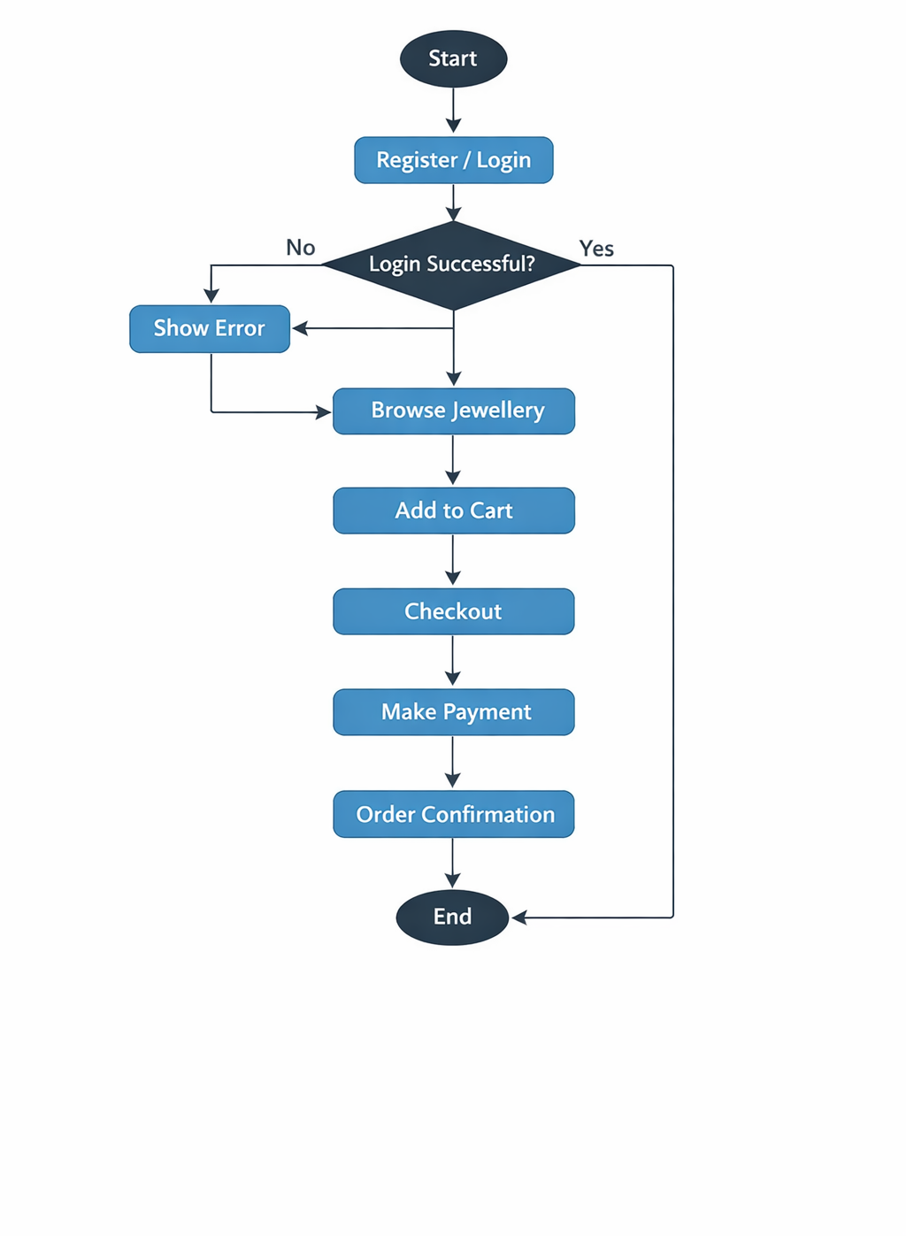

Slide 27
Sequence Diagram

Slide 28
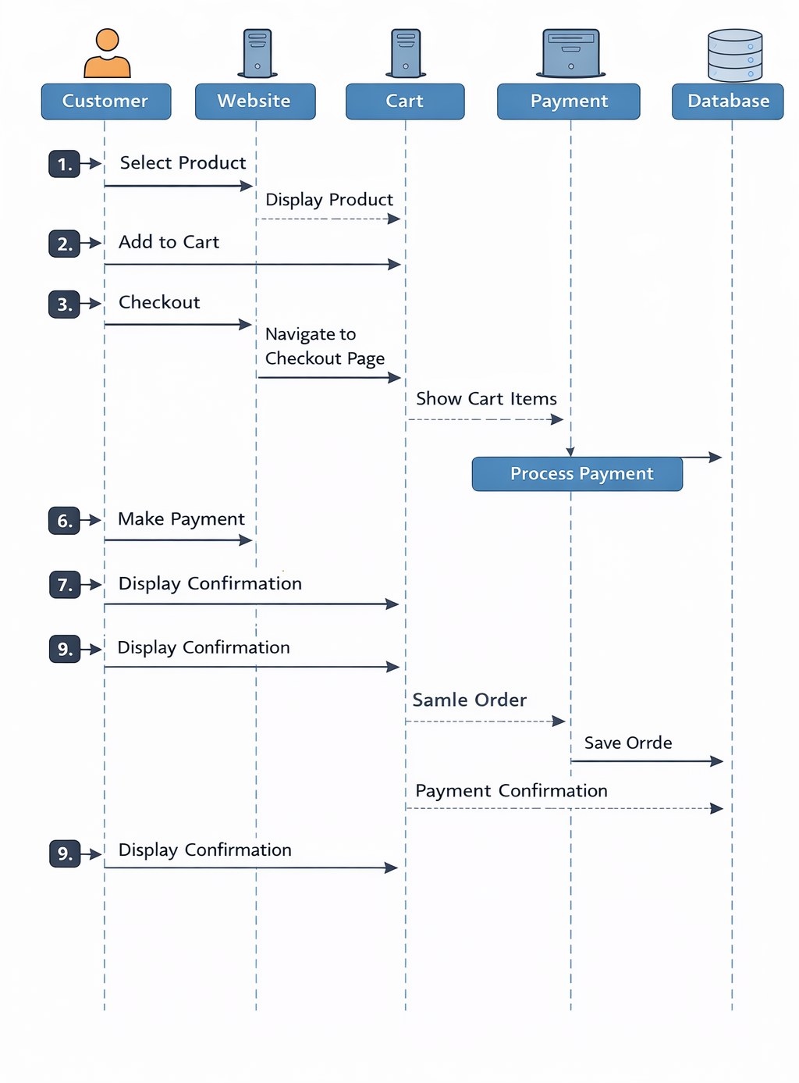

Slide 29
State Diagram

Slide 30
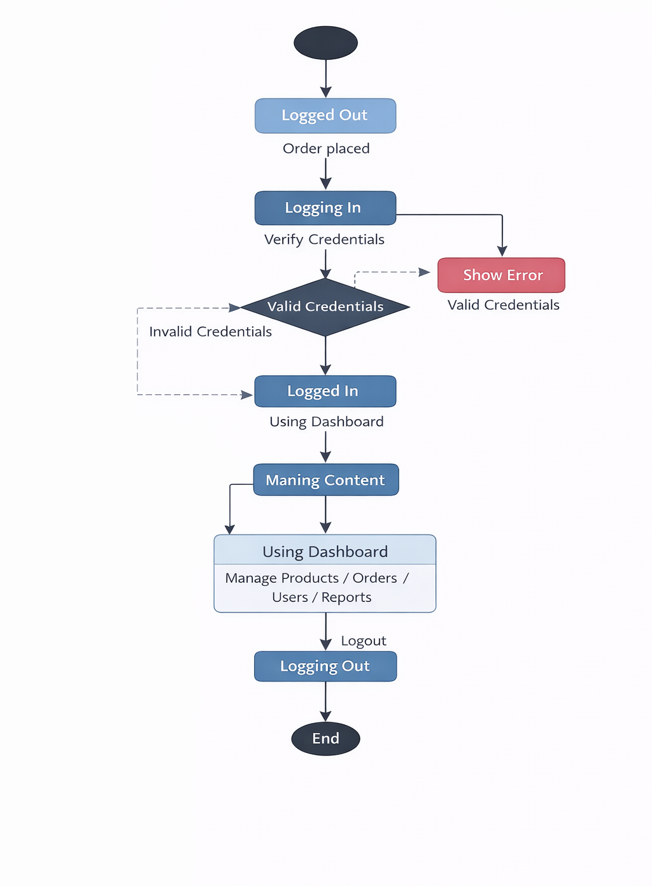

Slide 31
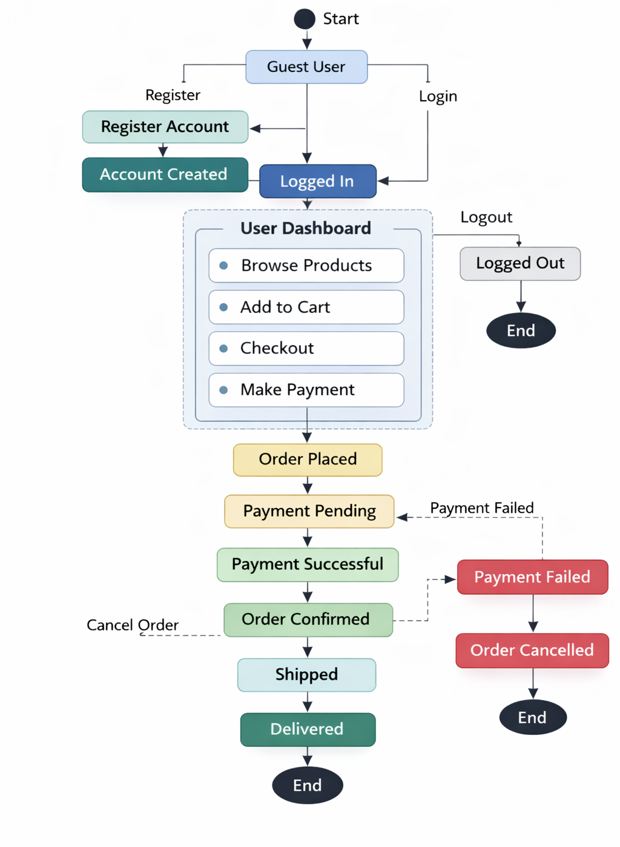

Slide 32
Deployment Diagram:-

Slide 33
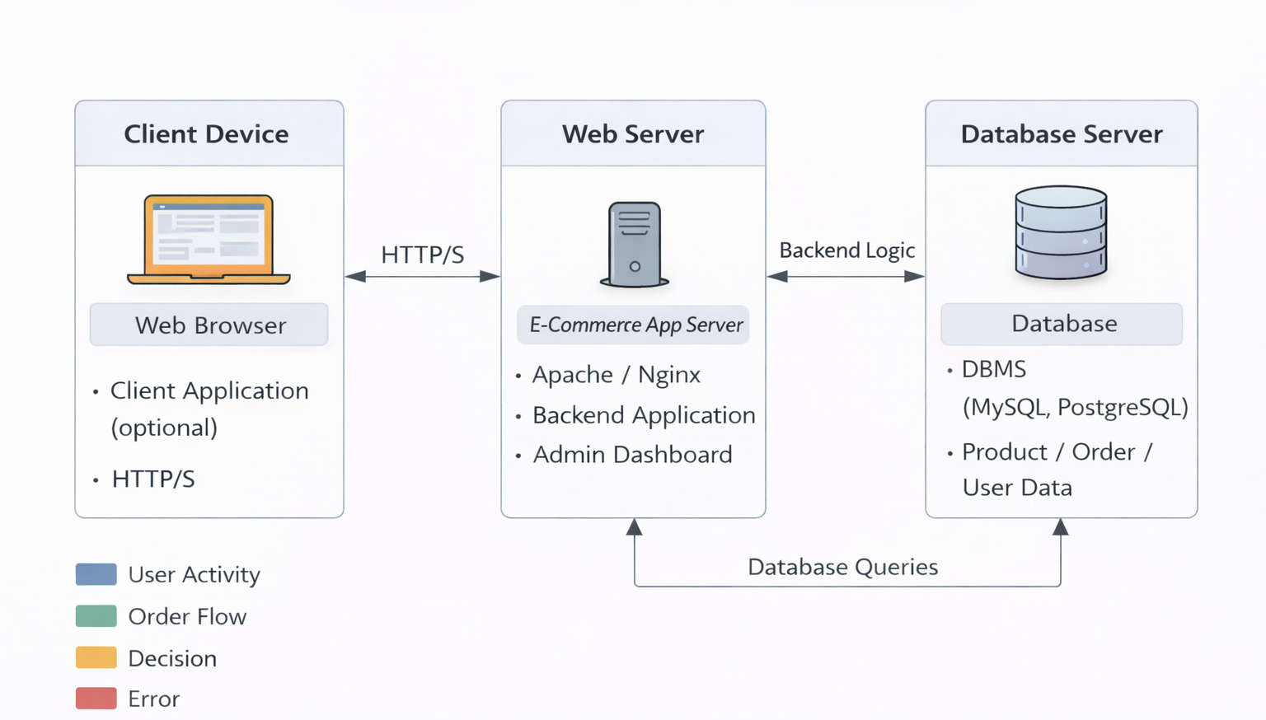

Slide 34
DATA DICTIONARY

Slide 35
1. User Table:-
Purpose: Handles user registration, login, and authentication
Description: Stores user and admin account details
Primary Key: id
Foreign Key: —
Unique Key: email
Field Name | Data Type | Description | Constraints
id | int | Unique user ID | Primary Key
email_verification_status | Bit | Email verification status | Not Null
otp | int | OTP number | Not Null
otp_time | datetime | OTP generated time | Not Null
email | varchar | User email | Unique
name | varchar | User name | Not Null
password | varchar | User password | Not Null
role | varchar | Role (Admin/User) | Not Null

Slide 36
2. CATEGORY TABLE:-
Description: Stores jewellery product categories such as Ring, Necklace, Earrings, etc. It helps in organizing products in the R.K system.
Primary Key: category_id
Foreign Key: —
Unique Key: category_name
Field Name | Data Type | Description | Constraint
category_id | INT | Unique ID for each category | PRIMARY KEY, AUTO_INCREMENT
category_name | VARCHAR | Name of category (e.g., Ring, Necklace) | NOT NULL
description | VARCHAR | Short description of category | NULL
status | ENUM('Active','Inactive') | Category status | DEFAULT 'Active'
created_at | DATETIME | Record creation date | DEFAULT CURRENT_TIMESTAMP
updated_at | DATETIME | Last updated date | ON UPDATE CURRENT_TIMESTAMP

Slide 37
3. Product Module:-
Purpose: Manages jewellery items available for sale
Table: Product
Description: Stores product details
Primary Key: product_id
Foreign Key: —
Unique Key: —
Field Name | Data Type | Description | Constraints
product_id | int | Unique product ID | Primary Key
name | varchar | Product name | Not Null
category | varchar | Jewellery category | Not Null
price | float | Product price | Not Null
stock | int | Available stock | Not Null
description | varchar | Product description | —
image | varchar | Product image | —

Slide 38
4. Cart TABLE:-
Purpose: Stores items selected by user before purchase
Description: Temporary cart storage
Primary Key: cart_id
Foreign Key: user_id, product_id
Unique Key: —
Field Name | Data Type | Description | Constraints
cart_id | int | Cart ID | Primary Key
user_id | int | Reference to user | Foreign Key
product_id | int | Reference to product | Foreign Key
quantity | int | Quantity | Not Null

Slide 39
5. Order Table:-
Purpose: Handles order processing and tracking
Description: Stores order information
Primary Key: order_id
Foreign Key: user_id
Unique Key: —
Field Name | Data Type | Description | Constraints
order_id | int | Order ID | Primary Key
user_id | int | User reference | Foreign Key
total_price | float | Total price | Not Null
status | varchar | Order status | Not Null
order_date | datetime | Order date | Not Null

Slide 40
6. Order Details Module
Purpose: Stores detailed product information per order
Description: Products inside each order
Primary Key: order_details_id
Foreign Key: order_id, product_id
Unique Key: —
Field Name | Data Type | Description | Constraints
order_details_id | int | Unique ID | Primary Key
order_id | int | Order reference | Foreign Key
product_id | int | Product reference | Foreign Key
quantity | int | Quantity | Not Null
price | float | Product price | Not Null

Slide 41
7. Payment Table
Purpose: Manages transaction details
Description: Stores payment information
Primary Key: payment_id
Foreign Key: order_id
Unique Key: —
Field Name | Data Type | Description | Constraints
payment_id | int | Payment ID | Primary Key
order_id | int | Order reference | Foreign Key
amount | float | Payment amount | Not Null
method | varchar | Payment method | Not Null
status | varchar | Payment status | Not Null
payment_date | datetime | Payment date | Not Null

Slide 42
8. Address Module
Purpose: Stores delivery addresses
Description: User address details
Primary Key: address_id
Foreign Key: user_id
Unique Key: —
Field Name | Data Type | Description | Constraints
address_id | int | Address ID | Primary Key
user_id | int | User reference | Foreign Key
address | varchar | Full address | Not Null
city | varchar | City | Not Null
state | varchar | State | Not Null
pincode | int | Pincode | Not Null

Slide 43
9.PROFILE TABLE
Purpose: Store user (admin/staff) account details
Description: Contains login credentials and personal information of users who manage the jewellery shop system
Primary Key: profile_id
Foreign Key: — (Not required)
Unique Key: username, email, phone_number
Field Name | Data Type | Constraints | Description
profile_id | INT | PRIMARY KEY, AUTO_INCREMENT | Unique user ID
full_name | VARCHAR(100) | NOT NULL | Name of the user
username | VARCHAR(50) | NOT NULL, UNIQUE | Login username
password | VARCHAR(255) | NOT NULL | User password
email | VARCHAR(100) | UNIQUE | Email address
phone_number | VARCHAR(15) | UNIQUE | Contact number
address | TEXT | NULL | User address
role | ENUM('admin','staff') | NOT NULL, DEFAULT 'staff' | User role
created_at | TIMESTAMP | DEFAULT CURRENT_TIMESTAMP | Account creation time
updated_at | TIMESTAMP | DEFAULT CURRENT_TIMESTAMP ON UPDATE CURRENT_TIMESTAMP | Last update time

Slide 44
Form Design

Slide 45
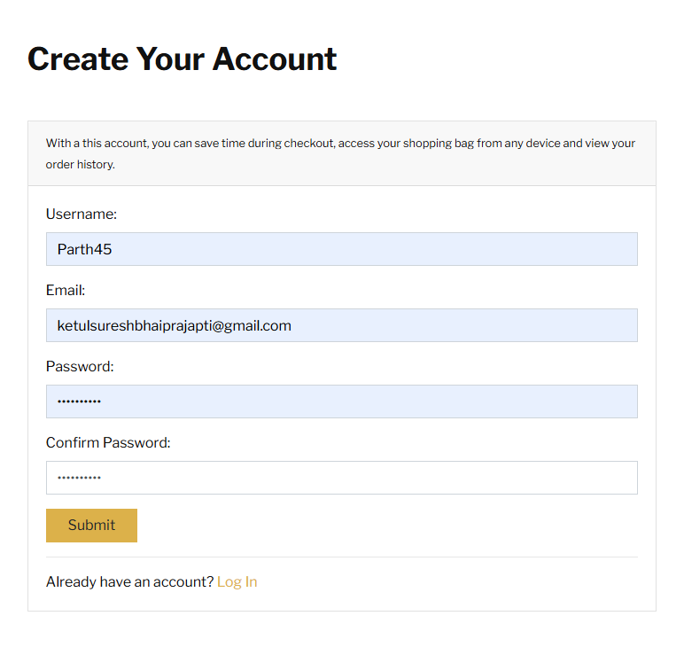
CREATE YOUR ACCOUNT

Slide 46
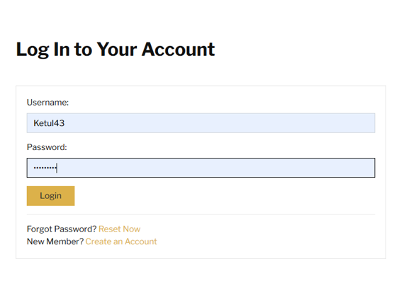
LOGIN TO YOUR ACCOUNT

Slide 47
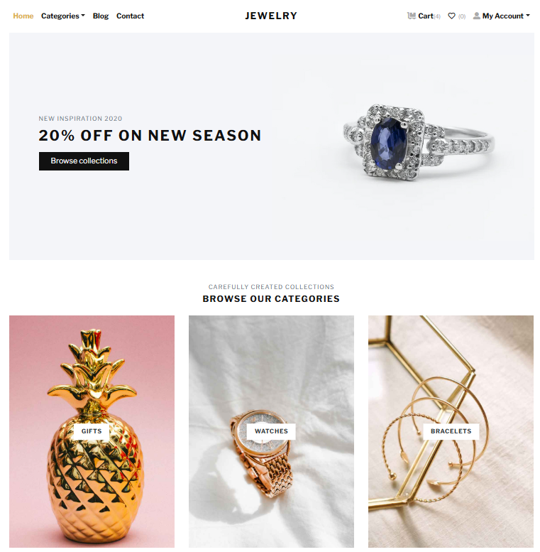
HOME PAGE

Slide 48
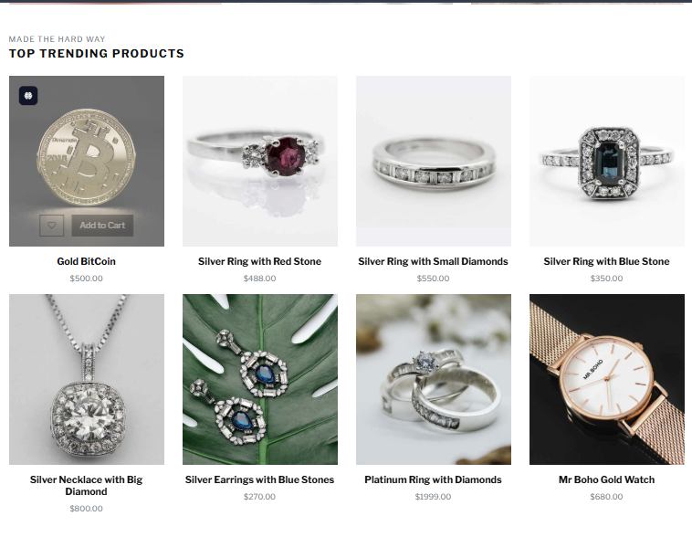
PRODUCTS

Slide 49
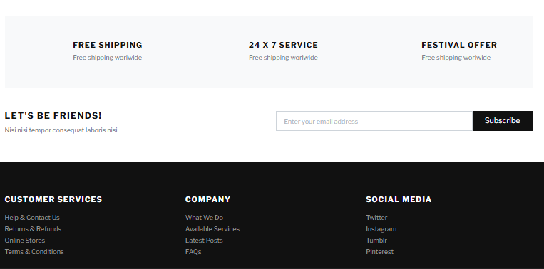
CONTACT AS

Slide 50
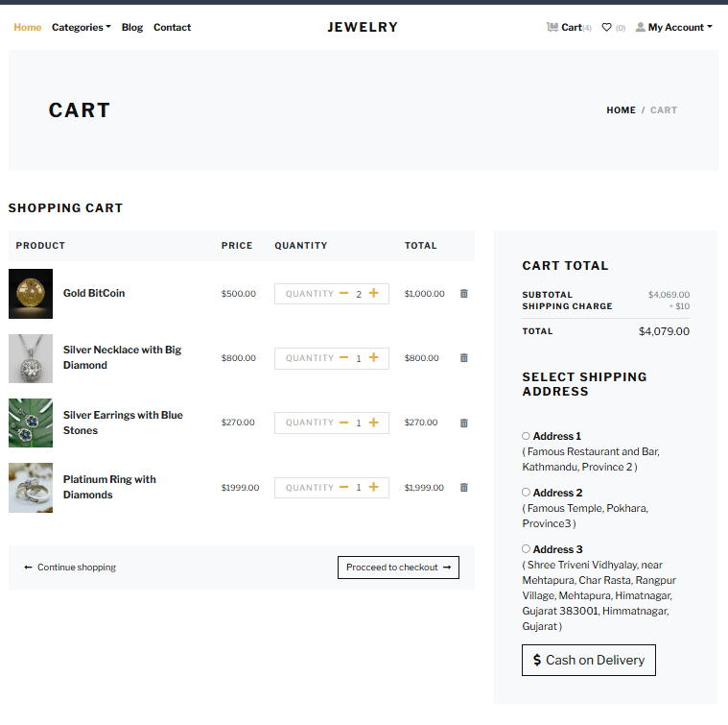
CARTS

Slide 51
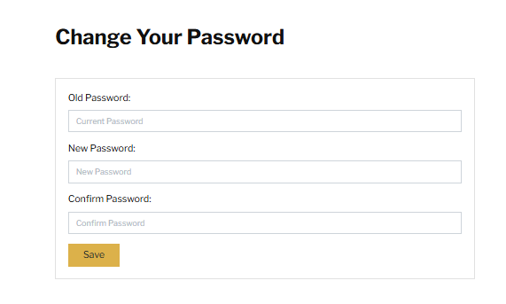
CHANGE YOUR PASSWORD

Slide 52
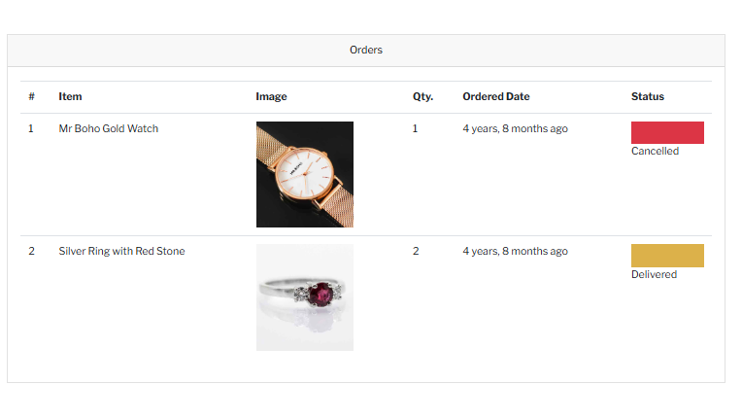
ORDERS

Slide 53
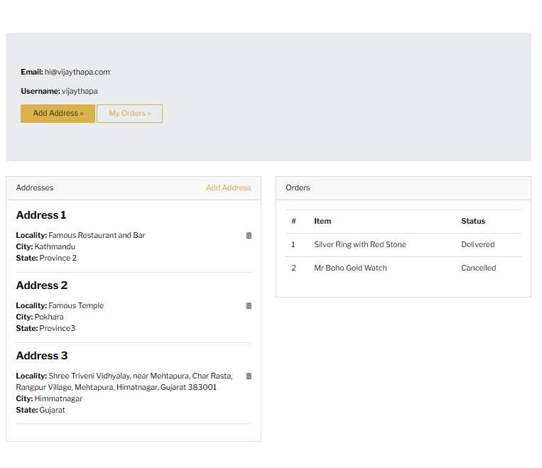
ADDRESSES

Slide 54
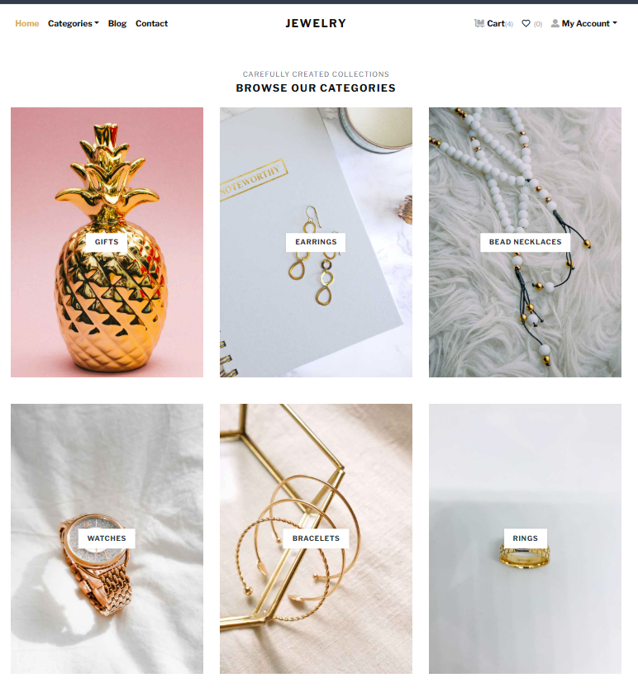
BROWSE OUR CATEGORIES

Slide 55
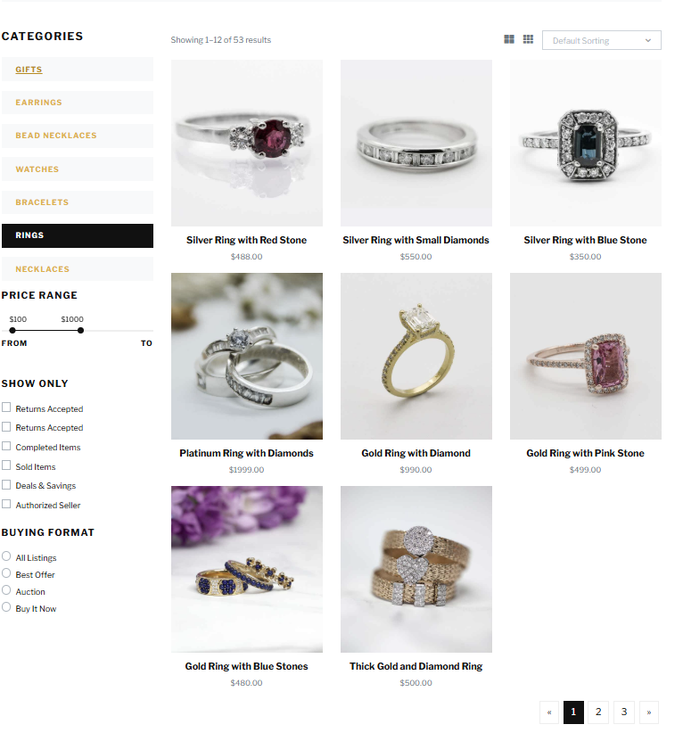
CATEGORIES

Slide 56
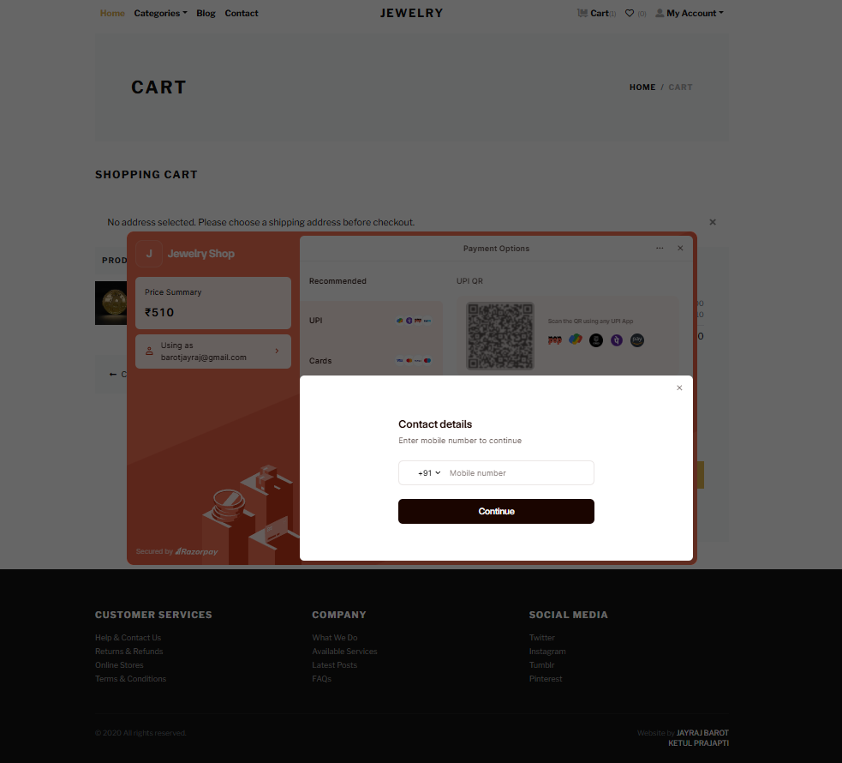
ONLINE PAYMENT

Slide 57
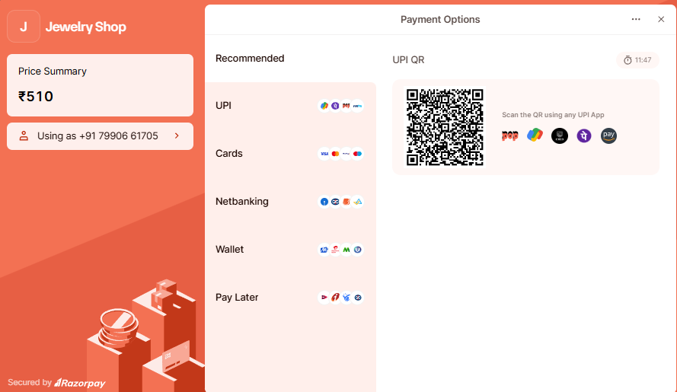
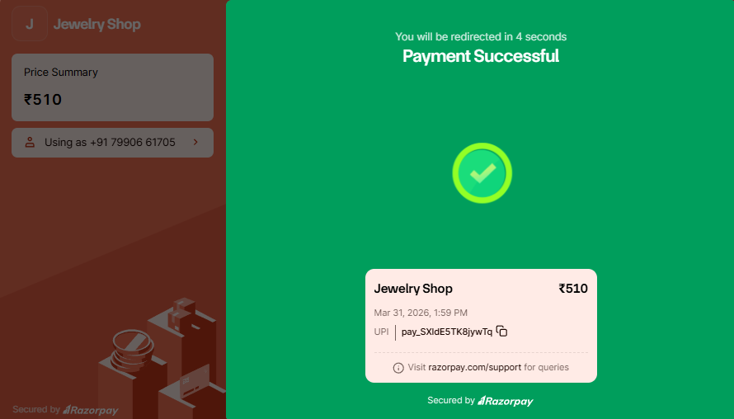
PAYMENT PROCESS
PAYMENT SUCCESSFUL

Slide 58
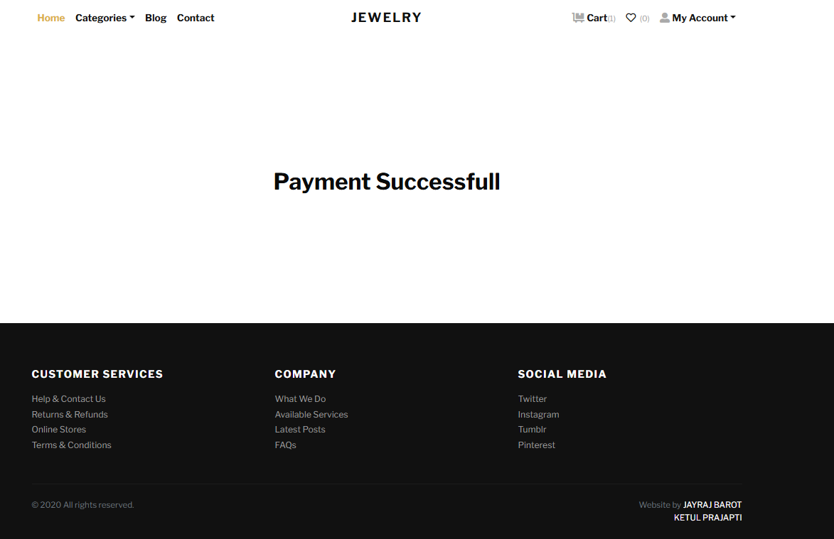
PAYMENT SUCCESSFULL

Slide 59
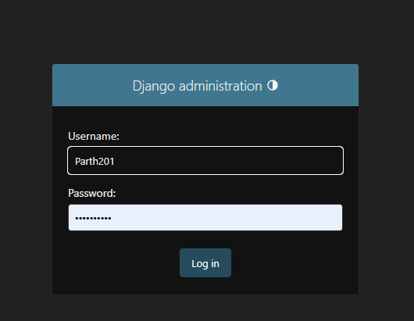
ADMIN

Slide 60
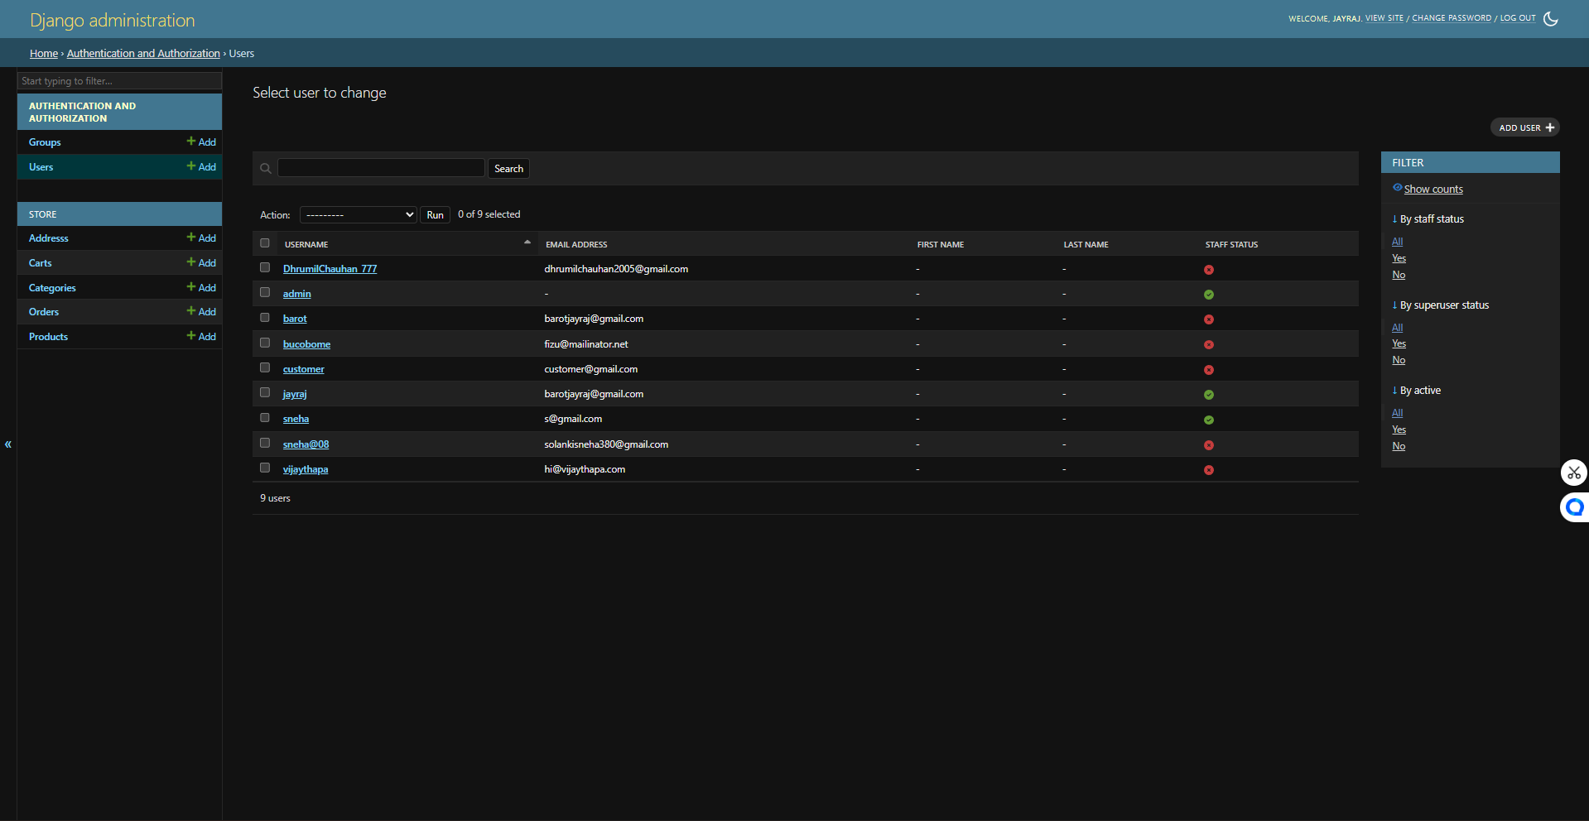
YOUR USERS

Slide 61
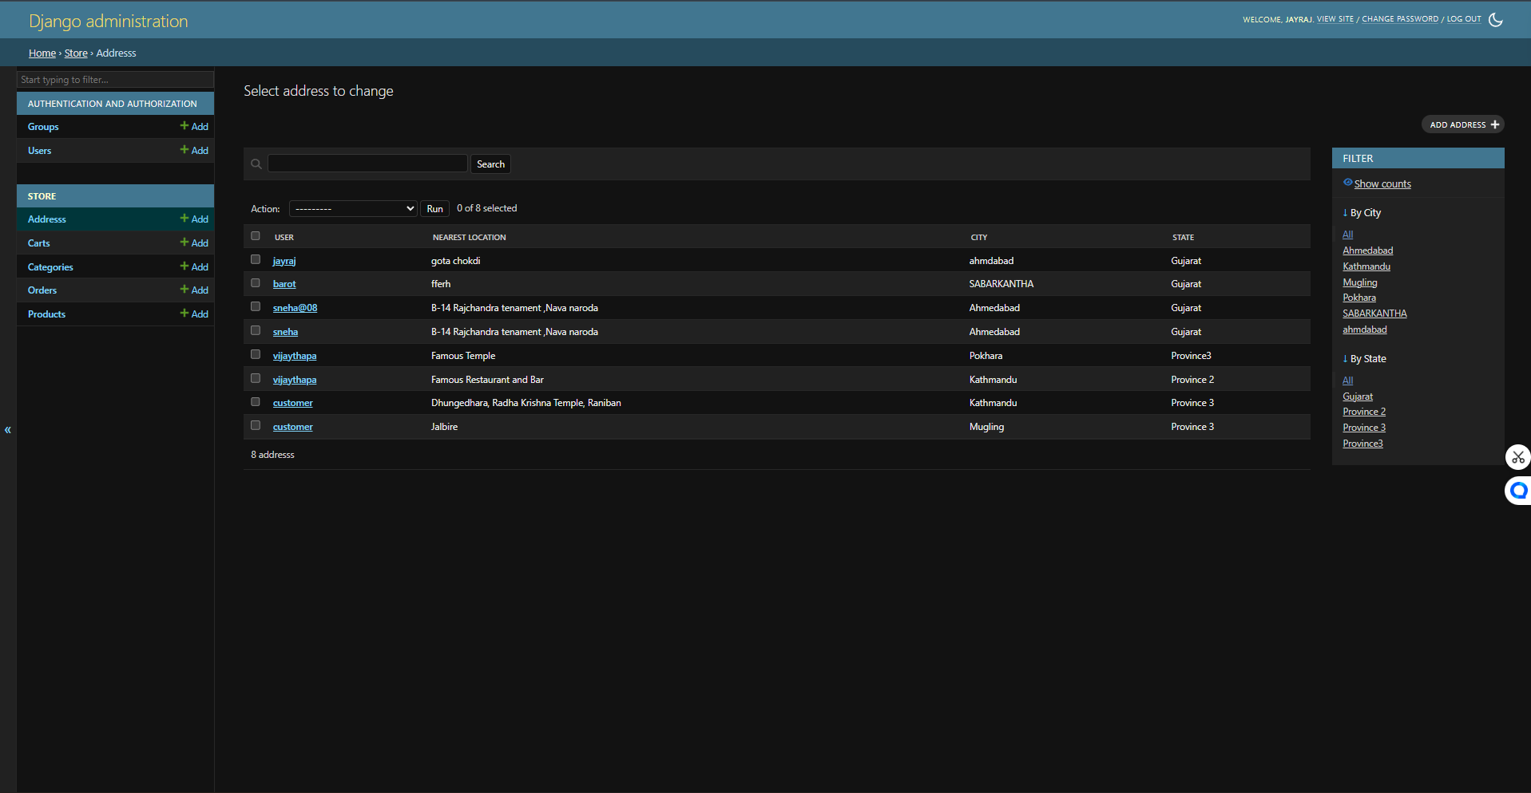
YOUR ADDRESSES

Slide 62
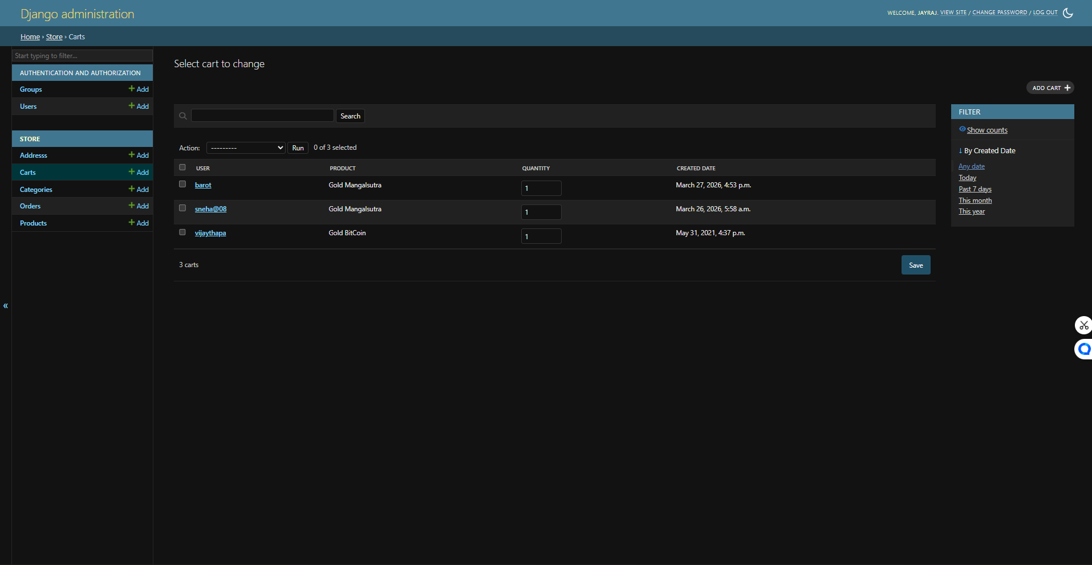
YOUR CARTS

Slide 63
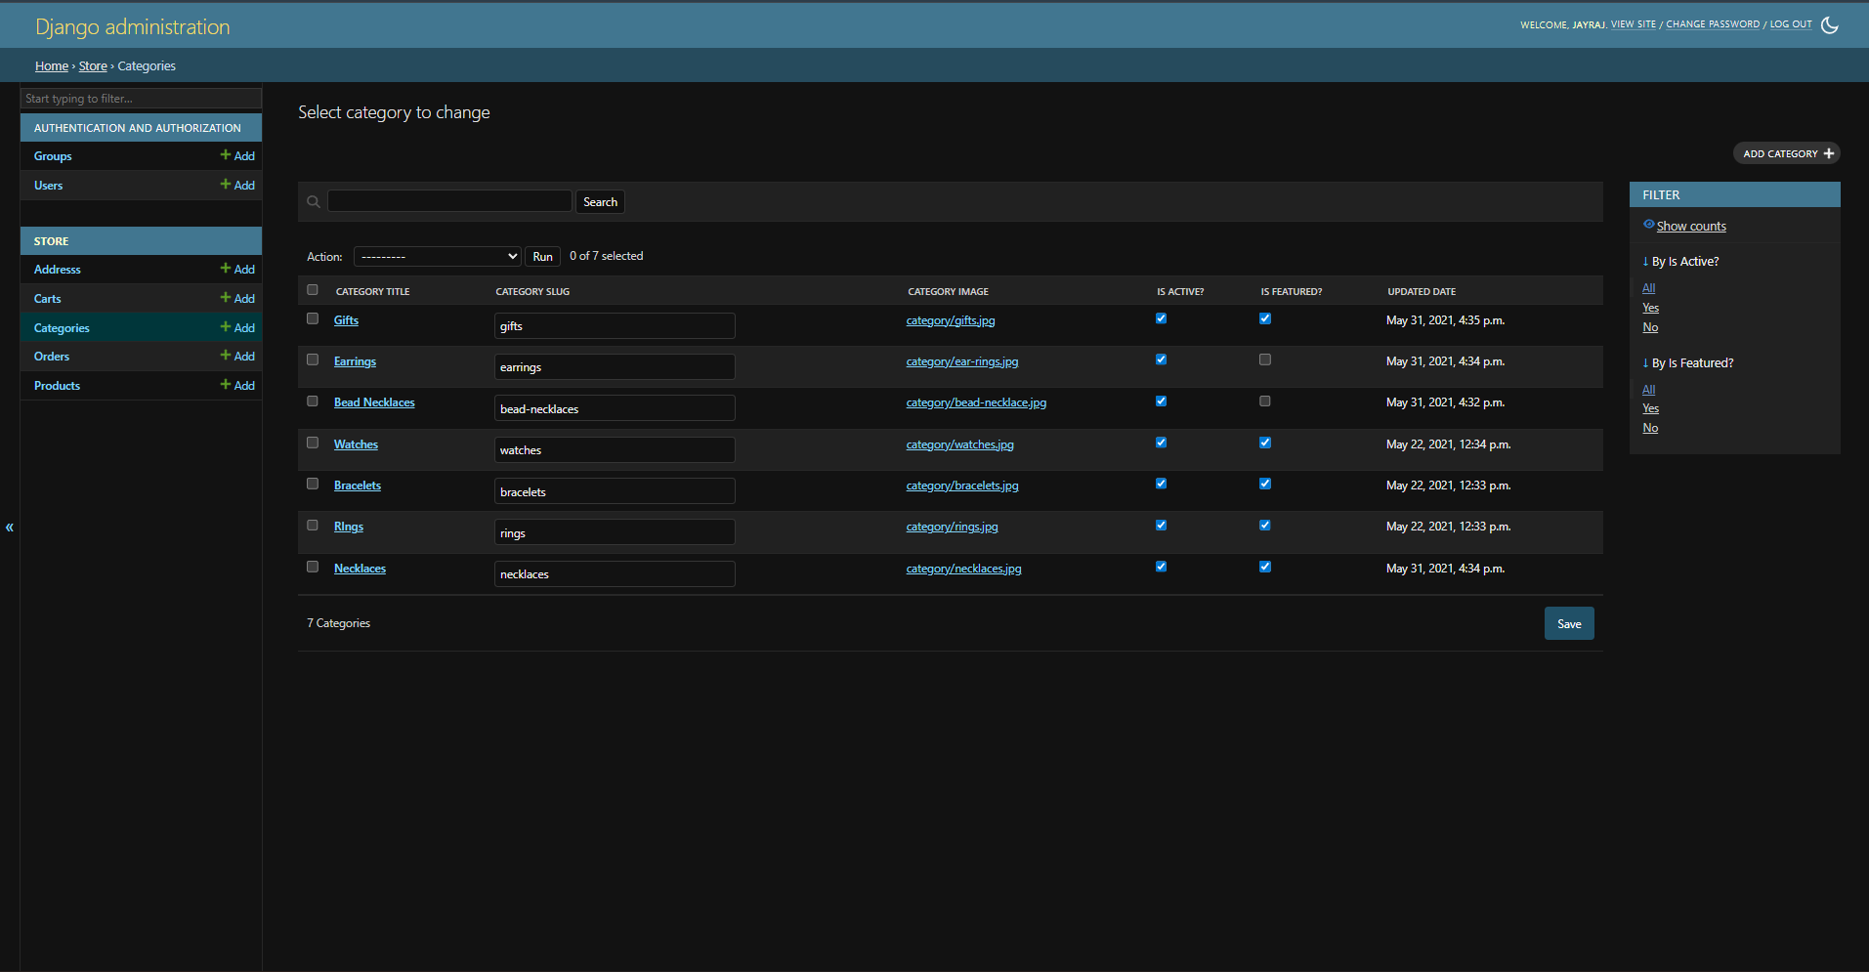
YOUR CATEGORY

Slide 64
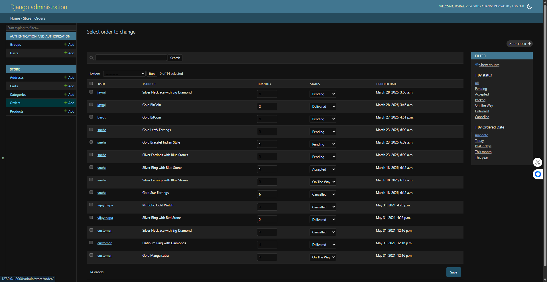
YOUR ORDERS

Slide 65
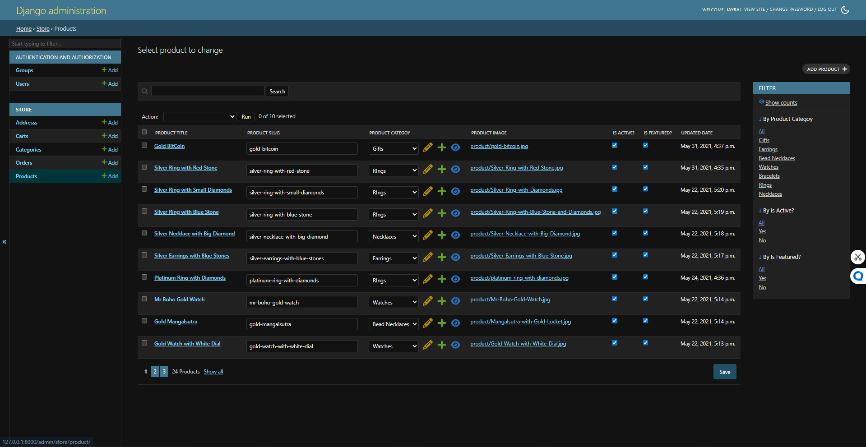
YOUR PRODUCTS

Slide 66
References
https://www.w3schools.com
https://getbootstrap.com/
https://docs.djangoproject.com/en/stable/
https://www.sqlite.org/docs.html
A Books for Django & Web Development …..
Django for Beginners
Authors
1. William S. Vincent
Python Crash Course
Authors
1. Eric Matthes
Learning Web Design (HTML, CSS, JS)
Authors
1. Jennifer Robbins

Slide 67
Thank You

